Slide 1
After the storm
Supporting Londoners beyond Covid-19
9th December 2020
Notes:
Thank you for having me.
Good to see several of the ppl I interviewed at this mtg.

Slide 2
Background to the report
Based on findings from a survey and from interviews with 17 members of the network
Focuses on funders’ current and future strategies
Range of funding organisations participated – large, small, public, private, local, London-wide, thematic
Notes:
There will be elements of the report that fit more with your experiences and ideas than others.
Hope this provides helpful overview.

Slide 3
Common approaches
Three areas funders are focusing on:
The need to plan in a flexible way
Changing ways of working
Supporting capacity building
Notes:
- Interest in taking more relational approaches & and the need to create opportunities.
- Desire to “think big” where possible. More longer-term funding. Open up conversations about doing things differently.
- Support grantees to renew & remain fit for the future.

Slide 4
Economic context
UK economy expected to contract by 11%
Peak in unemployment unlikely to be reached until early summer 2021
Funding gap for the year of ~£10bn
Not all organisations will survive
Notes:
Largest annual fall in 300 years.
Number of workers on payroll already fallen by 782,000
PBE survey with NCVO & IoF. Three quarters of charities expect demand for their services to rise over 2021. 80% expect income to fall.
The sector is facing a difficult future and funders acknowledge that.

Slide 5
Understanding Londoners’ needs
Common sets of needs identified:
Mental health support
Social isolation
Digital exclusion
Low income
Access to food
Jobs/employment
Notes:
Lots of surveys run; data analysis and conversations
Common themes, which fluctuations in demand. Mental health, low income & jobs/employment expected to rise.
Funders shifting away from crisis grants & planning for the future – with awareness of this context

Slide 6
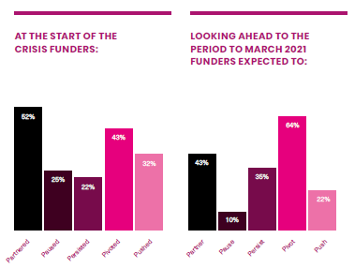
Survey findings
Notes:
Ran in October.
Continued interest in partnering
Coming out of pause. Majority expect to have to pivot their strategies

Slide 7
Insights from interviews
Three emerging themes:
Continued collaboration
Ways of working
Supporting capacity building
Notes:
17 interviewees. 8 questions focusing on future strategy plans.
Range of LF members with different governance, budget & funding models.
Highlights from my conversations.

Slide 8
Challenges
Three key challenges identified:
Expectation of a second wave of demand
Navigating the sector
Financial precariousness of the sector
Notes:
1) Unemployment expected to rise. Recession bites.
2) Identifying gaps, overlaps and commonalities as funders but also across the city & the work orgs are doing
3) Can’t fill the funding gap. What that means for maintaining social infrastructure. “Sector already felt precarious before the crisis.”

Slide 9
Looking to the future
Supporting relational approaches
Creating opportunities
Supporting learning
Notes:
Seen true collaboration over past few months.
Desire to continue that. More relational approaches.
Tension between wanting to think big but also not make any changes at a time of uncertainty.

Slide 10
Developing an opportunity narrative
Opening up conversations
Acting on the ideas being generated
Championing the sector
Notes:
Rather than the deficit narrative which is emerging, there is a chance to create more of an opportunity narrative.
What might funders do differently and where/when do you talk about that?
Standing with the sector – some tough years ahead. How can funders help champion the work of civil society groups. Hear a lot about the role of business. What about charities & the value they provide – as a service but also as social infrastructure.

